Slide 1
Role & Function of the FMCS
FY 2021
(Updated Jan, 2022)

Slide 2
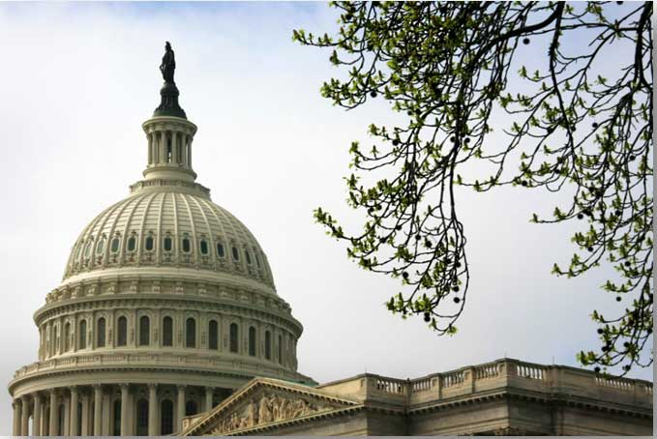
Statutory Mission...
Created in 1947 as an Independent agency under Taft-Hartley Act.
1
Neither a regulatory nor an enforcement agency, but a neutral party designed to assist labor and management.
2
Make available full and adequate government facilities for conciliation, mediation and voluntary arbitration to aid and encourage [the parties] to settle differences through collective bargaining.
3
Notes:
1947: Created as an Independent agency under Taft-Hartley Act
Neither a regulatory nor an enforcement agency, but a neutral designed to assist Labor & Management
Resolve collective bargaining disputes which threaten the free flow of commerce

Slide 3
Statutory Mission...
Helps parties resolve collective bargaining disputes which threaten the free flow of commerce.
4
Make its services available to Federal agencies to aid in the resolution of disputes through assistance, training, and the provision of neutrals.
5
Notes:
1947: Created as an Independent agency under Taft-Hartley Act
Neither a regulatory nor an enforcement agency, but a neutral designed to assist Labor & Management
Resolve collective bargaining disputes which threaten the free flow of commerce

Slide 4
FMCS Mission...
Promote sound and stable labor-management relations;
1
2
Prevent or minimize work stoppages;
3
Advocate collective bargaining, mediation, arbitration;
Notes:
1947: Created as an Independent agency under Taft-Hartley Act
Neither a regulatory nor an enforcement agency, but a neutral designed to assist Labor & Management
Resolve collective bargaining disputes which threaten the free flow of commerce

Slide 5
FMCS Mission...
Advocate the art, science and practice of ADR;
4
5
Provide conflict resolution services;
6
Foster improved labor-management relationships.
5
Notes:
1947: Created as an Independent agency under Taft-Hartley Act
Neither a regulatory nor an enforcement agency, but a neutral designed to assist Labor & Management
Resolve collective bargaining disputes which threaten the free flow of commerce

Slide 6
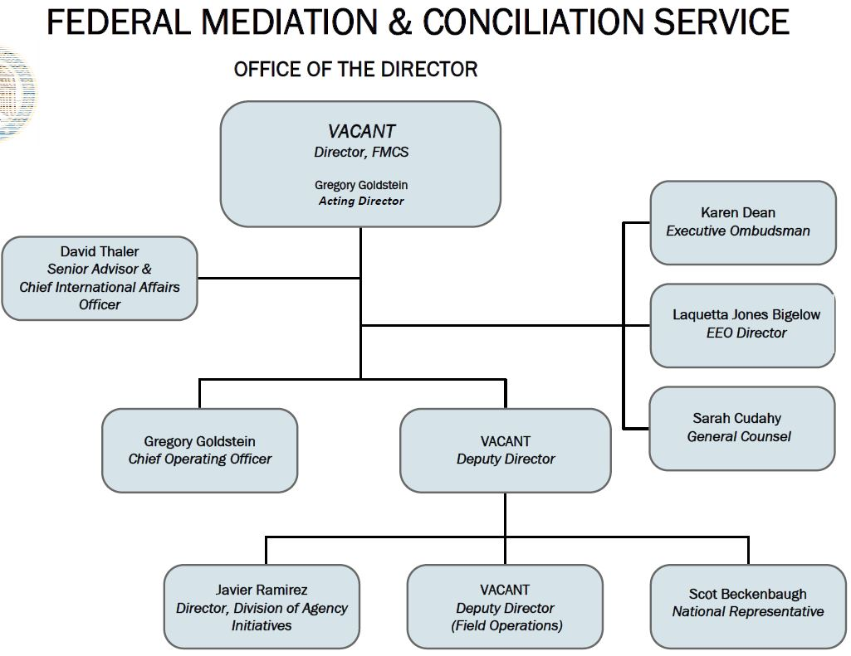
FMCS Office of the Director

Slide 7
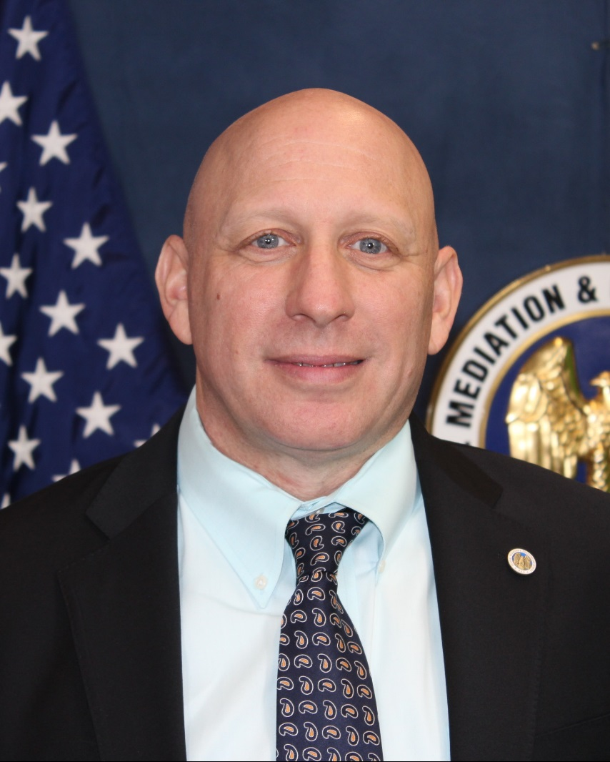
Office of the Director
Gregory Goldstein
Acting Director*/Chief Operating Officer
Joined FMCS in 2018; Mr. Goldstein’s 25+ year career in public service, business, and military life has included positions in the U.S. Marine Corps and Army National Guard, and most recently as a member of the Senior Executive Service, serving as Executive Officer and Director of Operations, Management and Technology Office within the Substance Abuse Mental Health Services Administration (SAMHSA).
Responsible for overseeing FMCS's critical operations initiatives. Mr. Goldstein’s considerable leadership and management expertise help to ensure proper development, execution, and coordination of the Agency's management and administrative functions.
*As of Jan, 2022
Notes:
1947: Created as an Independent agency under Taft-Hartley Act
Neither a regulatory nor an enforcement agency, but a neutral designed to assist Labor & Management
Resolve collective bargaining disputes which threaten the free flow of commerce

Slide 8
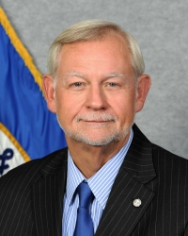
Office of the Director
Scot Beckenbaugh
National Representative
Serves as the Agency’s “master mediator” of high-profile collective bargaining disputes and is responsible for developing and coordinating increased engagement with FMCS customers for future relationship development and mediation opportunities in key industries and occupations.
He has extensive experience in public sector dispute mediation, as well as in regulatory negotiations, public policy, land use, and civil rights disputes. A long-time member of the Association of Labor Relations Agencies, Mr. Beckenbaugh also serves on the ALRA Executive Board.
Notes:
1947: Created as an Independent agency under Taft-Hartley Act
Neither a regulatory nor an enforcement agency, but a neutral designed to assist Labor & Management
Resolve collective bargaining disputes which threaten the free flow of commerce

Slide 9
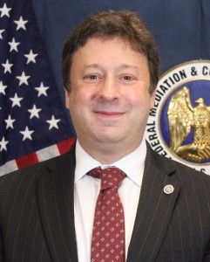
Office of the Director
David Thaler
Senior Advisor, Office of the Director
Has trained labor and management partners in many industries in core relationship and communications skills to help them better administer their collective bargaining agreements.
Internationally, Commissioner Thaler has trained officials from several U.S. and foreign government agencies in mediation and conflict management.
Notes:
1947: Created as an Independent agency under Taft-Hartley Act
Neither a regulatory nor an enforcement agency, but a neutral designed to assist Labor & Management
Resolve collective bargaining disputes which threaten the free flow of commerce

Slide 10
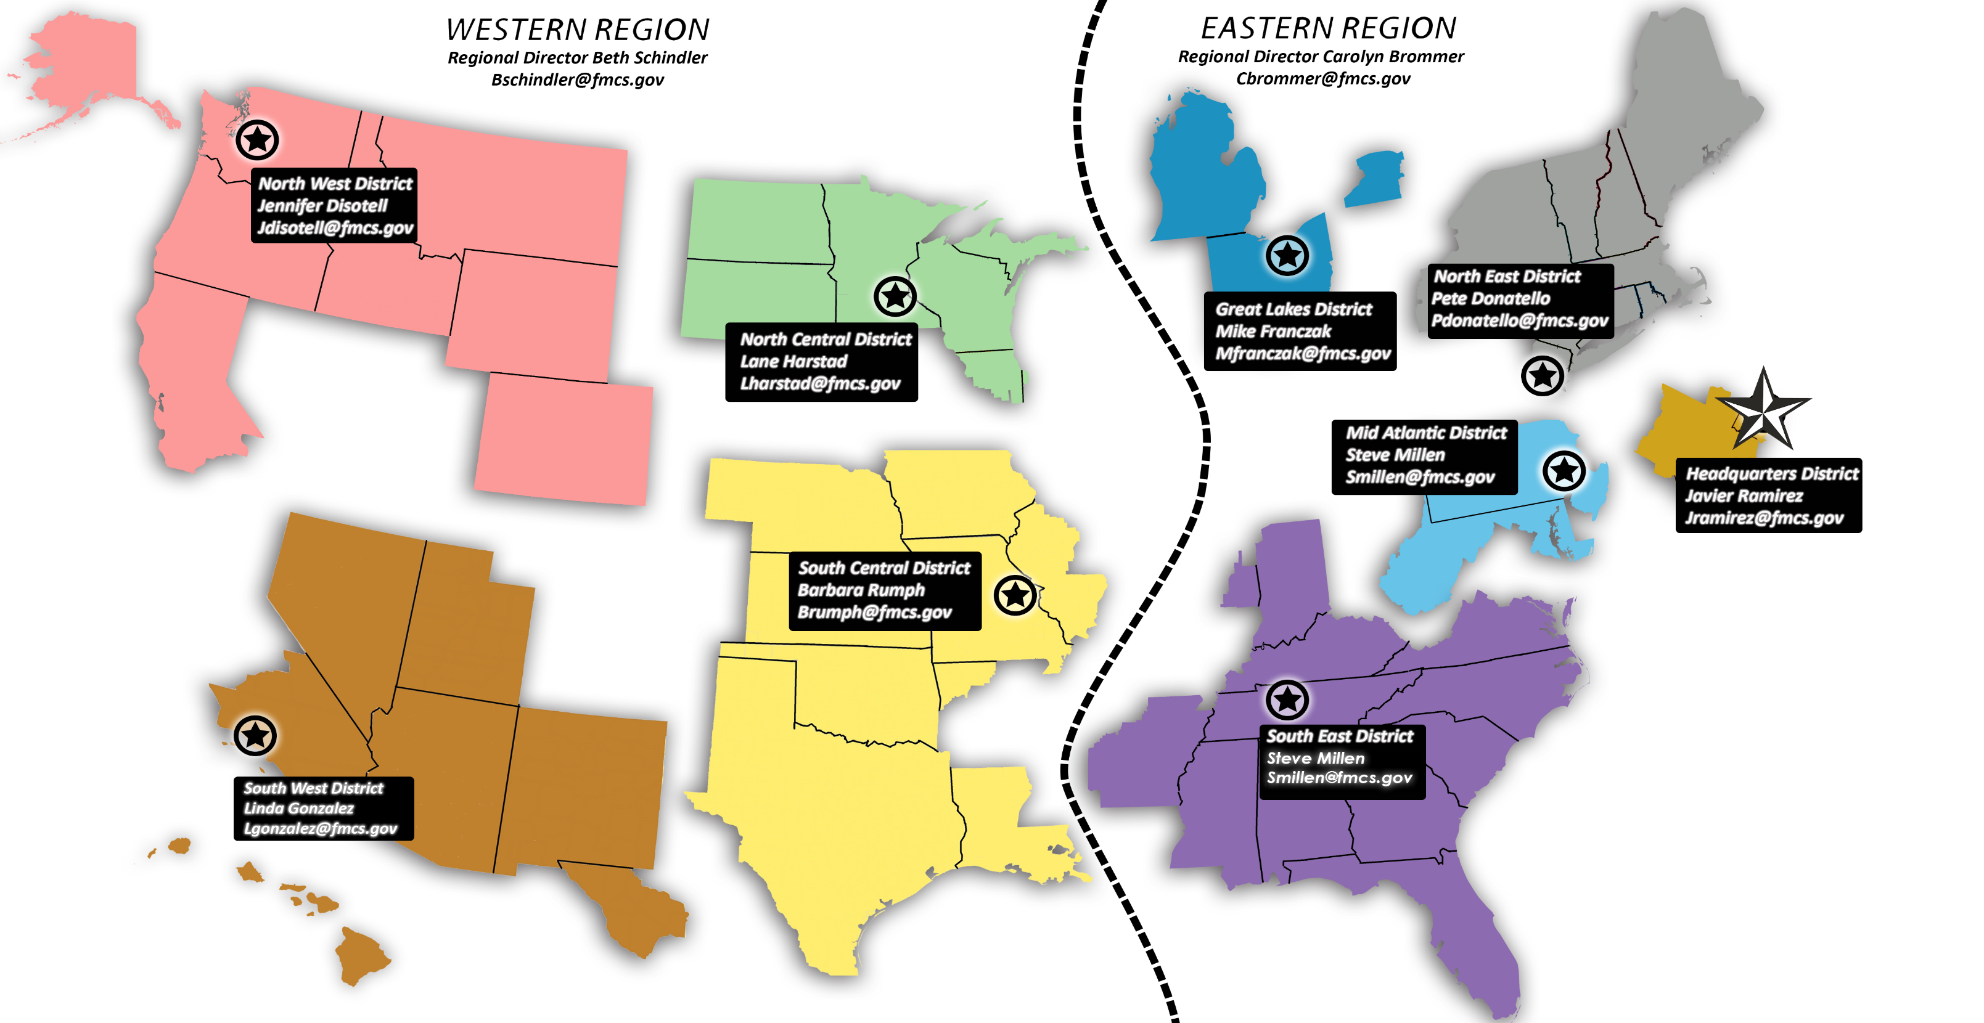
FMCS Structure
Headquartered in
Washington, DC
63 HQ personnel*
203 FTEs nationally*
*As of Jan, 2022

Slide 11
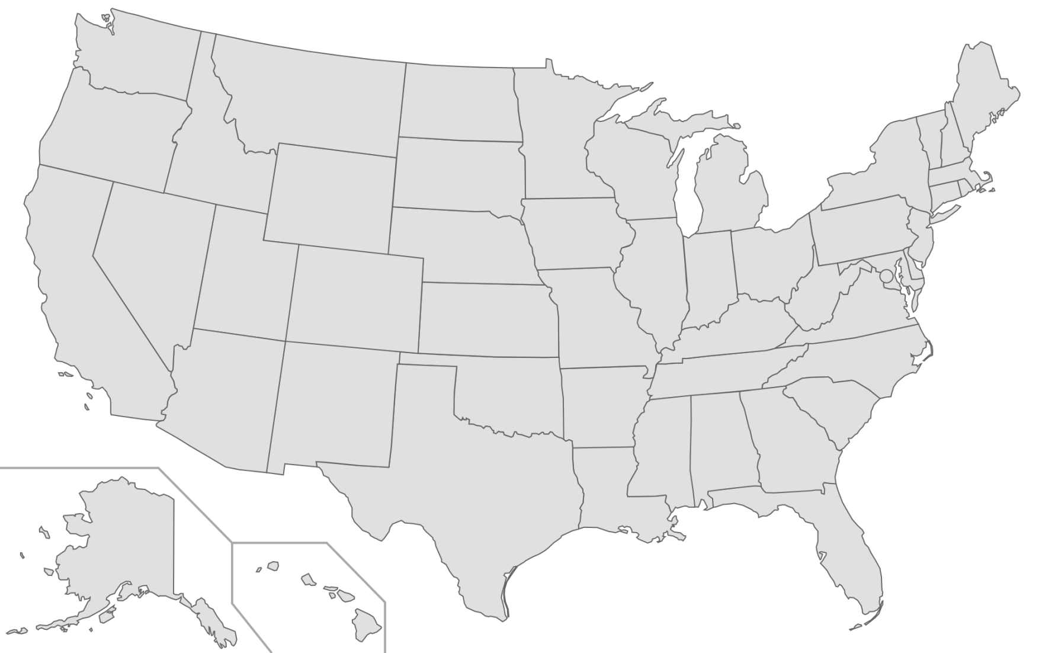
FMCS Structure
8 District Offices*
67 Field/Local Offices*
140 field mediators*
9 district administrative staff*
*As of Jan, 2022

Slide 12
FMCS: How Can We Help You?

Slide 13
How Can Mediation Benefit You?
Mediation, the use of a third-party neutral, can help you “bridge the gap.”

Slide 14
Mediation:
An Effective Tool for Conflict Resolution
Parties retain control of resolution
Voluntary (in most cases)
Informal vs. formal process
Time efficient
Cost effective
Notes:
1947: Created as an Independent agency under Taft-Hartley Act
Neither a regulatory nor an enforcement agency, but a neutral designed to assist Labor & Management
Resolve collective bargaining disputes which threaten the free flow of commerce

Slide 15
A Federal Mediator Can:
Help Parties
Clarify issues
Define problems
Generate options
Explore alternatives
Notes:
1947: Created as an Independent agency under Taft-Hartley Act
Neither a regulatory nor an enforcement agency, but a neutral designed to assist Labor & Management
Resolve collective bargaining disputes which threaten the free flow of commerce

Slide 16
A Federal Mediator Can:
Help Parties
Keep talks moving forward
Make suggestions
Establish realistic expectations
Notes:
1947: Created as an Independent agency under Taft-Hartley Act
Neither a regulatory nor an enforcement agency, but a neutral designed to assist Labor & Management
Resolve collective bargaining disputes which threaten the free flow of commerce

Slide 17
FMCS Services

Slide 18
FMCS Services
COLLECTIVE BARGAINING MEDIATION
Private, Public, and Federal Sectors
RELATIONSHIP DEVELOPMENT AND TRAINING
Customized training for labor and management
GRIEVANCE MEDIATION

Slide 19
FMCS Services
ARBITRATION SERVICES
Maintains a nationwide roster of highly qualified arbitrators and promotes the advancement of fair and effective labor arbitration
EDUCATION, ADVOCACY, and OUTREACH
Of Collective Bargaining and Dispute Resolution Processes and Services

Slide 20
FMCS Services
EMPLOYMENT MEDIATION and NON-COLLECTIVE BARGAINING ADR SERVICES
As an alternative to litigation of non-labor employment disputes, public policy and regulatory disputes
Includes consultation, convening, design, training, and neutral services

Slide 21
FMCS Services
CONFLICT MANAGEMENT AND PREVENTION SERVICES FOR GOVERNMENT
Outside the collective bargaining arena, FMCS provides employment mediation services to the Federal sector and to state and local governments.
Our services help reduce litigation costs and promote better government decision-making.

Slide 22
FMCS Services
SHARED NEUTRALS PROGRAM
Interagency mediation program administered by FMCS in the national capital area
Provides collateral duty, non-FMCS neutrals to participating Federal agencies for mediation of non-complex cases

Slide 23
FMCS Services
FMCS INSTITUTE
Unique Training
The FMCS Institute for Conflict Management delivers conflict resolution training that’s accessible, practical, experience-based and directed towards individuals and small groups of employees and managers.

Slide 24
The Impact of Mediation on the Bargaining Process

Slide 25
FMCS By the Numbers
A National Look – FY 2021*
Mediated 2,788 Collective Bargaining negotiations
Mediated 1,967 high-impact Grievance Mediations
Mediated 1,169 ADR cases
*FMCS Closed Case Data

Slide 26
FMCS By the Numbers
A National Look – FY 2021*
Conducted 1,284 single or multi-day Training and Intervention Programs
Provided 10,544 Arbitration Panels
Appointed 4,417 Arbitrators
*FMCS Closed Case Data

Slide 27
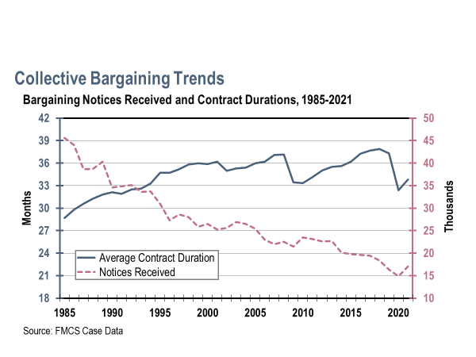
Collective Bargaining Trends
Bargaining Notices Received and Contract Durations, 1985-2021
Source: FMCS Case Data

Slide 28
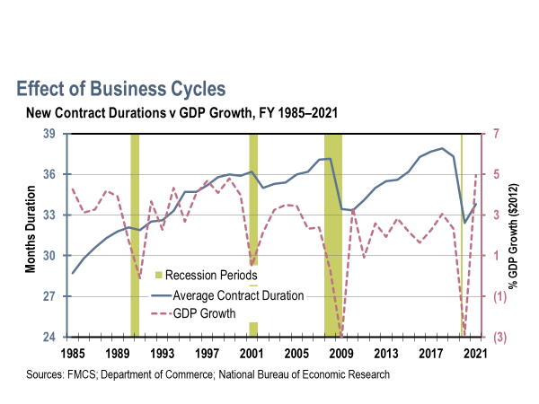
Effect of Business Cycles
New Contract Durations v GDP Growth, FY 1985–2021
Sources: FMCS; Department of Commerce; National Bureau of Economic Research
Notes:
28
FMCS Fiscal Years: 1985-2004, Casemain system; 2005-present, CCMS
Commerce Dept. (BEA) Years: Q3 1984-Q3 2018 (Chained $2012) T10106-Q ([Millions of chained (2012) dollars] Seasonally adjusted at annual rates)
**** Each new FY, add 12 months to NBER data range and make sure underlying recession chart is the identical size

Slide 29
FMCS Services
ARBITRATION
Through its Office of Arbitration, FMCS administers a roster of approximately 1,000 highly qualified and experienced arbitrators.
Arbitrators are selected for the roster based on standards of excellence in a process overseen by the Arbitration Review Board and subject to approval of the Agency Director.

Slide 30
FMCS Services
ARBITRATION SERVICES
In FY 2021, FMCS provided more than 10,544 arbitration panels to requesting parties, with 4,417 appointments from the FMCS roster by the requesting parties to hear their dispute.

Slide 31
Cooperative Relationships
Keys to Cooperative Relationships of Any Kind
COMMUNICATION
(Develop joint problem-solving teams)
COMMUNICATION
(Be honest about issues)
1
3
2
COMMUNICATION
(Don’t let problems fester)
COMMUNICATION
(Know when to get help)
4

Slide 32
For more information: www.fmcs.gov
Follow us:
Twitter: /fmcs_usa
Facebook: /fmcs.usa
YouTube: /fmcsinfo

Slide 33
THANK YOU.
FMCS I 250 E Street, SW I Washington, DC I 20427

